Slide 1

Scrum-Agile Approach

Slide 2
Scrum Agile Roles
Product Owner – Responsible for maximizing the value of the product and work of the Development Team (Cobb)
Cleary express the Product Backlog and order it
Ensure the Backlog is transparent, clear and shows what the team will work on
Ensure the Development Team understands items in the Product Backlog to the level needed

Slide 3
Scrum Agile Roles
Scrum Master – Responsible for ensuring Scrum is understood and enacted, also support the Development Team (Cobb)
Ensure the Product Owner knows how to arrange the Product Backlog
Serve the Development team with coaching, helping, removing impediments and facilitating Scrum Events
Finding techniques for effect Product Backlog

Slide 4
Scrum Agile Roles
Developer – Professionals who work and deliver on Sprints (Cobb)
Cross-functional and Self-Organizing with all the skill as a team to create project
Scrum recognizes no sub-teams regardless of specialized skills
Work on the Product Backlog with no one telling the Team how to turn the Product Backlog into releasable functionality

Slide 5

Agile Phases

Slide 6
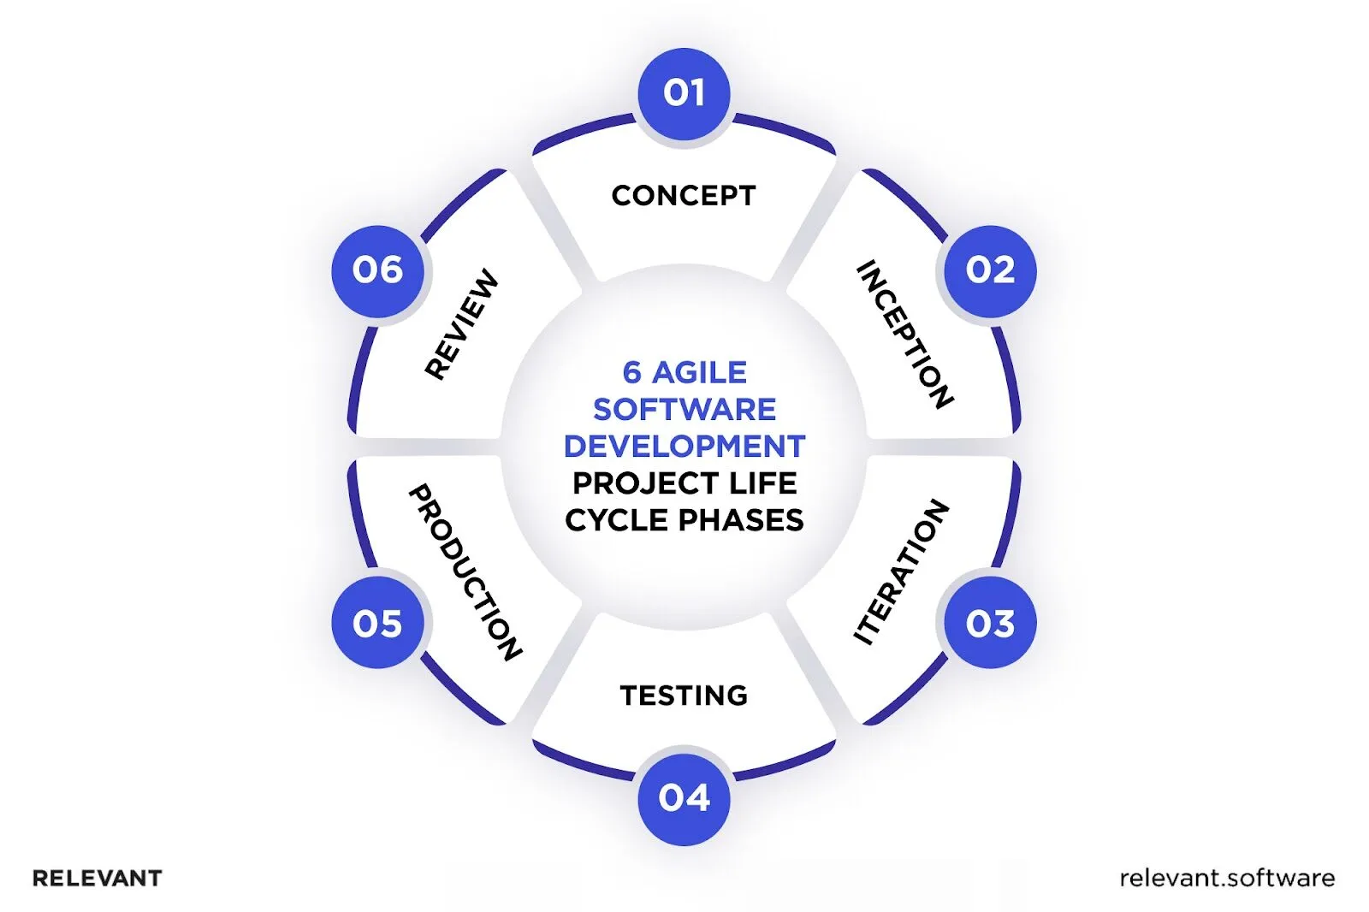

Slide 7
Phase 1 - Concept
Stakeholders and product owners join forces to outline the project’s scope and priorities (Relevant Software)
They scrutinize costs, projected completion time, desired features, and requirements to determine the project’s feasibility

Slide 8
Phase 2 - Inception
The founder selects the appropriate team members, assigns roles, and provides the necessary tools to begin development (Relevant Software)
Establish a plan and define the core set of methods and templates for future development activities. This includes:
UI/UX design
Product architecture

Slide 9
Phase 3 - Iteration
Close cooperation between developers and UI/UX designers to ensure that all business needs and feedback are incorporated (Relevant Software)
The iteration (or development) stage is fundamental to the agile approach, allowing the team to build a product with minimal features, with additional functionality added later
Once the development stage is complete, it’s time to conduct quality assurance activities, create technical documentation, and end the iteration.

Slide 10
Phase 4 - Testing
After testing the digital product at the end of every sprint, the final testing phase is conducted to ensure the software operates flawlessly (Relevant Software)
The Agile life cycle incorporates various types of testing, including:
Unit Testing Integration Testing
Acceptance Testing System Testing

Slide 11
Phase 5 - Release
Deliver a dependable and efficient product that meets customers’ requirements (Relevant Software)
Once all the final testing and verification are completed, the product is prepared for launch
When the dedicated team ends all the activities, they pass to the final phase

Slide 12
Phase 6 - Review
Once an Agile software development project reaches this stage, the focus shifts from striving for a triumphant launch to sustaining long-term triumph (Relevant Software)
The product has been released successfully, and customers frequently provide feedback, request new features, or interact with recent updates
The development and operations teams and stakeholders are now tasked with providing continuous support for the application to ensure it operates effortlessly

Slide 13



Describing Waterfall Model

Slide 14
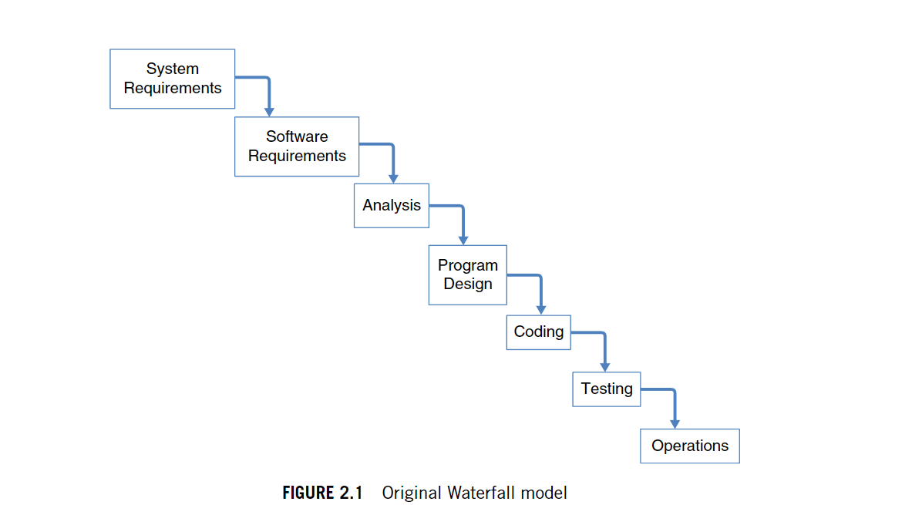

Slide 15
How Waterfall Works
The first phase of the Waterfall model is to gather all the requirements for the project, which are usually outlined by the client (Klein)
The team will conduct interviews, research and review existing documentation to determine what needs to be done
To understand what a business organization needs, you must first listen to its stakeholders and collect as much information as possible

Slide 16
When Should you use Waterfall?
Clear objectives and deliverables, providing a structured path from start to finish (Klein)
Fixed requirements (including deadlines) and minimal anticipated changes
Industry regulations that require strict adherence and extensive documentation
Tasks that must occur in a specific order, and where one task must be completed before starting another

Slide 17

Waterfall or Agile Approach?

Slide 18
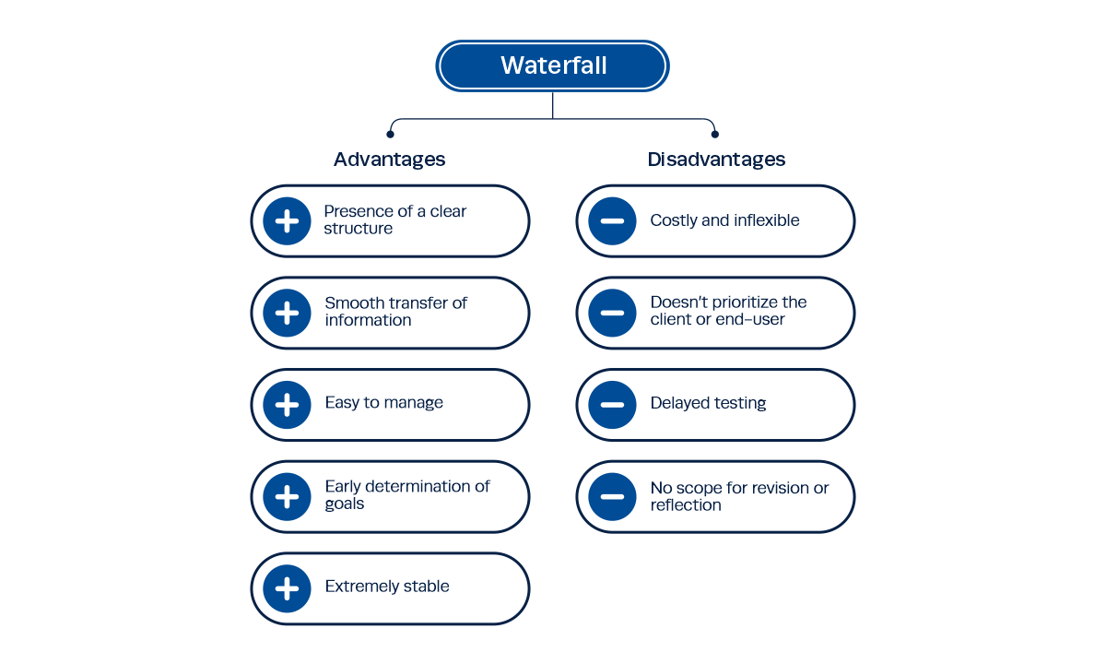
Institute of Project Management

Slide 19
Pros and Cons of Waterfall
Works best when there are defined requirements
Best for stable environment
The team is distributed, and control can be managed through deliverables, milestones and dependencies
Plans are repeatable for similar projects
Requires investment to define scope and schedule before work begins
Scope changes can be slow and the adverse impact increases over the life cycle
Risk of nothing to show for the money until the end
Change adds effort and risk, so change control must be in place to avoid scope creep
Institute Project Management

Slide 20
Pros and Cons of Scrum
Works well when the detailed requirements are unknown or subject to change
Give flexibility to adjust course
Needs regular stakeholder feedback
The team is multi-functional and enables to work in a collaborative way
Early return on investment by regular delivery
No advantage for projects where the scope and detail and well understand
Uncertainty around scope and schedules can make stakeholders nervous
Less effective if the ‘team’ is distributed
Demands management and prioritization of the backlog
Institute Project Management

Slide 21
References
Charles G. Cobb. (2015). The Project Manager’s Guide to Mastering Agile : Principles and Practices for an Adaptive Approach. Wiley.
Navigating the agile software development life cycle: Phases, tools, roadmap. Relevant Software. (2024, October 3). https://relevant.software/blog/agile-software-development-lifecycle-phases-explained/
Klein, M. (2024, September 27). Waterfall model methodology: Everything you need to know. project. https://project-management.com/waterfall-model/
Singh, R. (2024, October 9). What is waterfall methodology: Everything you need to know: IPM. Institute of Project Management. https://instituteprojectmanagement.com/blog/waterfall-methodology/

Slide 22

Thank you
Mitchell Gossman
Southern New Hampshire University
CS 250: SDLC

